Slide 1
Lectures on French Theatre of 1930s to 1970s
Politics, Aesthetics, Sensation

Slide 2
Outlaw politics, not the politics of ideologues
Antonin Artaud – drug addict, visionary, mentally disturbed, committed to theatricality as something visual and gestural
Jean Genet – thief, queer, prisoner, committed to producing a theatre that provokes, that uses shit against shit
Marguerite Duras – feminist, alcholic, self-confessed ‘salope’ (The 343; 1971)

Slide 3
Main argument expressed by lectures is that French theatre offers a type of politics in which what matters is not content as such, but rather the search for a form in order to produce a type of shock.
We could call this sensate politics, affective politics, a theatre of force in which the body of spectator is the thing to be targeted.
The point is not, as Jean Cocteau says, to speak poetry on the stage, but to mine the poetry of the stage.

Slide 4
French theatre
Influenced by avant-garde aesthetics – in particular Surrealism;
A theatricality theatre from Jacques Copeau
Theatre where training, the body are more important than text;
Theatre, too, where there is a spiritual and political mission
Theatre is a National Theatre, like a kind of rite or ceremony

Slide 5
Keywords to think about
Formal experimentation/rites/ceremonies
Erotics/Sexuality/Gender
Cruelty
Bodies
Theatricality
Force
Anti-France, anti-bourgeois, negationist
Creative destruction

Slide 6
Antonin Artaud
(1896- 1948)

Slide 7
Artaud’s influence (Carl Lavery)
In recognition of his profound but delayed influence on the physical theatres of the 1960s, the Polish director Jerzy Grotowski pronounced in the revolutionary year of 1968 that ‘we are entering the age of Artaud’ (1975: 117). An equally laudatory declamation is made for Artaud’s significance by Gilles Deleuze and Félix Guattari. In their purposively sprawling 1980 epic, Mille Plateaux, Deleuze and Guattari proclaim that ‘even if Artaud did not succeed for himself, it is certain that through him something has succeeded for us all? (1987: 164). Taken together these statements underscore the magnitude of Artaud’s contribution to late twentieth-century culture, the fact that what was ‘transmitted’ through his ‘aborted theatre’ transformed both theatre practice and philosophy by placing the body centre stage and advancing a theory of aesthetico-political affect or sensation – what Deleuze and Guattari term, in a direct reference to his work, ‘the body without organs’. In Artaud’s theatre, in his desire, we might say, for ‘mobile transmission’, the corporeality of the gesture has greater transformative weight than the semantic of the word. The word is a cultural sign, the gesture a biosemiotic one – a kind of force, a jet, a projectile that is launched by a body, something sensate, something with heat.

Slide 8
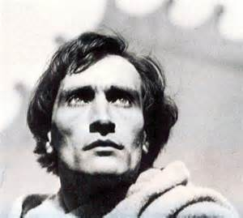

Slide 9
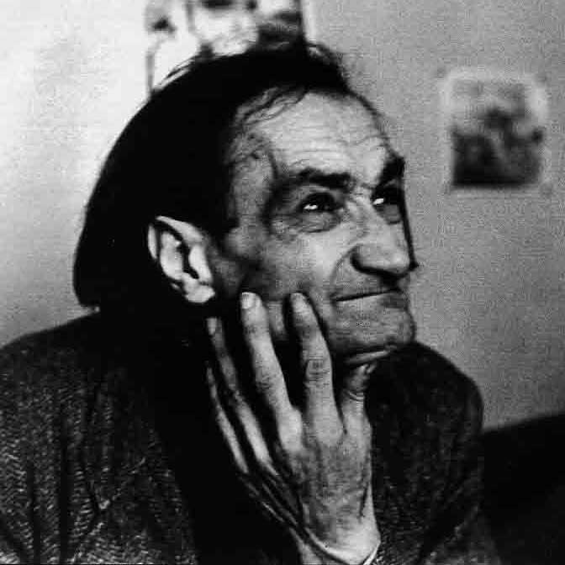

Slide 10
Structure: Cruelty to be kind
Who is Antonin Artaud? Stage of his career
Principles of his theatre - cruelty
His Legacy – the impossible theatre

Slide 11
So who is Artaud
Born in Marseilles 1896
Illness, anxiety, time in clinics
Missed World War I, but his whole career in a way is marked by that – huge numbers dead in France, veneer of civilization lifted, poison gas, propaganda, the end of reason and rational debate, a recognition of European violence, and how bourgeois culture/ capitalism is an inhuman business, bound up with alienation and reification

Slide 12
Antonin Artaud (1896: 1948)
Artaud most important theatre-maker in 20th century
He offers a revolutionary concept/practice of performance rooted in affect, sensation, and on exploring the theatricality of the medium itself
He is often contrasted with Brecht – the cerebral, political performance maker
Artaud is interested in sacred/mystic/energetic theatre – a theatre of the body, affect/sensation
He sees theatre as a kind of spell, a living dream, not entertainment – it offers spiritual, existential and political hope.
He wants to heal us from a sick society – theatre as cure, something salvific, homeopathy

Slide 13
Surrealism performance/Artaud – juxtaposition, collage and montage, dream time, an experience and event, a presentation, audience members to be targeted, to be made active, a rejection of psychology, script, character, Aristotelian and naturalistic theatre, theatre closer to cinema in a sense, but also emphasis on theatre’s physicality, a sensorium, language as sound, scenography, lighting, a move away from character, as hero, theatre as a kind of canvas. Everything happening now. Theatre as a material; as presence, as therapeutic. This looks forward to absurd theatre of 1950s, sacred theatres of 60s and 70s, directors theatre of 80s and 90s, and postdramatic theatres of 90s and 2000s

Slide 14
Antonin Artaud (2016): David A. Shaffer
‘From start to finish, there is constancy to Artaud’s writings and ideas: they scream (sometimes literally) alienation and rebellion; rebellion against the bourgeois values of his youth; the privileging of Western cultural norms, including reason and rationality; and rebellion against the authorities; the power of wealth; and the subversion of nature…,Artaud’s revolution was over the cultural space of meanings, understandings, representations, signs’ (8)

Slide 15
Artaud poet – ‘The Nerve Meter’ (1925)
Artaud’s career starts with the Surrealists – he is the secretary of the movement.
Same avant-garde interest in tapping the unconscious, the interest in dreams, in rejecting bourgeois life for the erotic, fantastic, the animist, the ‘primitive’ – to make contact with himself differently
At this stage Artaud is primarily a poet – focused on strange, internal dream images, drug hallucinations, states where he is not himself (Je est un autre, Rimbaud{

Slide 16
Artaud – film-maker (1925-8)
In line with Surrealism, Artaud is interested in the production of images that would shock, that would transform life by entering through our retinas
He does actor training – physical training with Charles Dullin and acts on stage – but his major concern is with cinema at this stage
Writes screenplay – Seashell and Clergyman (1928) - and roles in two hugely important films – Napoleon and the Passion of Joan of Arc

Slide 17
Théâtre Alfred Jarry 1920w
Artaud works with Roger Vitrac to found a surrealist theatre
This would be a theatre of dreams, in which gestures, transformations, absurd incidents, provocations, violence are at the heart of theatrical experience
So Artaud wants a visual theatre, performance for the eye
A theatre that rejects ‘naturalist’ and ‘symbolist’ ideas of drama – naturalism too realistic; symbolism too passive, polite, not aggressive enough
A redemptive violence

Slide 18
The Jet of Blood (1925)
A theatre of animals, wild weather, nudity, sexual transgression, attack on bourgeois family
The text is very short – no real plot or characters; dialogue is absent. They speak to each other but no response.
Everything in a sense is on the surface; dream logic; we look at images and materials; more painterly than written
A young man tries to find his lover and ends up meeting a bawd, a medieval knight, a wet-nurse with lactating breasts, etc.

Slide 19
Cruelty texts
Throughout Artaud’s career but is expressed in one essay; 2 manifestos; and 2 letters, all in his collected writing on theatre: Theatre and Its Double (1938)

Slide 20
Titles
Key essays here are:
Theatre and the Plague
No More Masterpieces
Theatre and Cruelty
Theatre of Cruelty (First Manifesto and Second)
Letters on Cruelty
‘The idea that we can be healed through cruelty’
Theatre as a medicinal space’

Slide 21
Theatre and Cruelty
Cruelty not physical but psychic, but it works through bodies, as an affect
‘We are not free and the sky can still fall on our heads. And above all else theatre is made to teach us this (Artaud)’.
But cruelty is not literal; it is only by a rigorous attention to form, composition, dramaturgy.
It is not about participation or body art, or blood letting;
It is about affecting us through the movement of the performance – through images, sounds

Slide 22
Letters on Cruelty: what is cruelty?
‘I do not systematically cultivate horror. The word cruelty must be taken in a broad sense, and not in the rapacious physical sense that it is customarily given… One can very well imagine a pure cruelty, without bodily laceration. And philosophically speaking, what indeed is cruelty? Cruelty signifies rigor, implacable intention and decision, irreversible and absolute determination’ (101).

Slide 23
Cruelty as cleansing/poison to cure
Theatre’s poison, injected into the social body, disintegrates it, but at least it does so as a plague, as redeeming epidemic’ (31)
The action of theatre like the plague…is beneficial, for impelling men to see themselves as they are’ (31)

Slide 24
How to produce cruelty
Language is broken down into sound and noise ---not dispensed with but given role as in dreams
Rejection of psychology – Racinian tragedy and naturalism…towards a dream logic, a logic of myths, and hidden images
Gestures/tableaus/stage images/props/objects
Costume, puppets, masks
Lighting, scenography, dream time, rejection of scripts
Musicality/sound design
Stage redesigned for direct contact; scale; actors and audiences in the same space; actors running all around them on galleries and ramps; abandon traditional theatre building move to environmental theatre and site specificity
Actor not playing a character, but part of a score, a neutral vessel at times
So an assault on senses

Slide 25
Cruel Theatre: A non-humanist theatre
Artaud’s whole project is to produce a new type of spectator
One who is in contact with unconscious drives and bodily energies
He is more concerned with the cosmos, animal, earth than with the human
But this anti-humanist theatre – rooted in what Artaud calls ‘plague’, ‘cruelty’, ‘the ‘double’ – is also a political theatre – one that wants a different life:

Slide 26
Humanist Theatre
A theatre of words, characters and stories, a theatre of entertainment, a Brechtian theatre, a theatre of representation (naturalism).
Artaud wants a theatre where we are placed in contact with chaos, the mysteries of the universe, secrets of life and death.
He wants a ritualistic theatre, a dangerous theatre that would put identities at risk
That would change us, existentially, socially, anthropologically

Slide 27
‘On the Balinese Theatre’
‘It is a theatre which eliminates the author in favor of what we call, in our Occidental theatre jargon, the director; but a director who has become a kind of manager of magic, a master of sacred ceremonies’ (Theatre and Its Double, 1958: 60)

Slide 28
‘Van Gogh: A man Suicided by Society’ (1948)
Note the term ‘suicided’. Society is behind it. A sick society no place for the artist of vision:
‘Things are going badly because sick consciousness has a vested interest right now in not recovering from its sickness. This is why a tainted society has invented psychiatry to defend itself against the investigations of superior intellects whose faculties of divination would be troublesome’.

Slide 29
Artaud’s politics
Artaud not, in any way, interested in ideology
Left the Surrealists because of their attachment to Communist Party
His aim is to destroy and eradicate the European subject – to reject reason, rationality, economics, God – and to find a way of existing differently, so that we are open to change, transformation, the irrational
To make life into a form of art – Nietzsche and Freud are huge influences – will to power/unconscious/ releasing desires

Slide 30
‘The Theatre and Culture’
‘That said, we can begin to form an idea of a culture, an idea which is first of all protest. A protest against the senseless constraint imposed upon the idea of culture….A protest against the idea of culture separated from life’ (Theatre and its Double, 10-11)
‘I believe that our present social state is iniquitous and should be destroyed’ (ibid., 42)

Slide 31
Total revolution
Artaud looking for a total revolution – this part of the avant-garde dream
The production not of an ideology but of a whole way of looking at existence
A new way of relating to cosmos, to sexuality, to life, theology, death, nature, to colonized peoples, body-mind, to work, art:
‘In Mexico, there is no art: things are made for use. And the world is in perpetual exaltation’ (ibid., 11)

Slide 32
Artaud’s breakdown
Artaud major problem with drug abuse – heroin – and heads to Mexico in 1935
The aim of the trip is to find a non-European source of life, to think of other, non-capitalist, non-bourgeois ways of living, a different kind of knowledge
Shaminism, ritual, peyote, to become cosmic
But Artaud starts to suffer psychosis, schizophrenia, and on returning to Europe has a major breakdown in Dublin.
He went there to find Druidic magic
He spends 1937-1945 in numerous asylums, where he underwent 55 electro-shock therapies

Slide 33
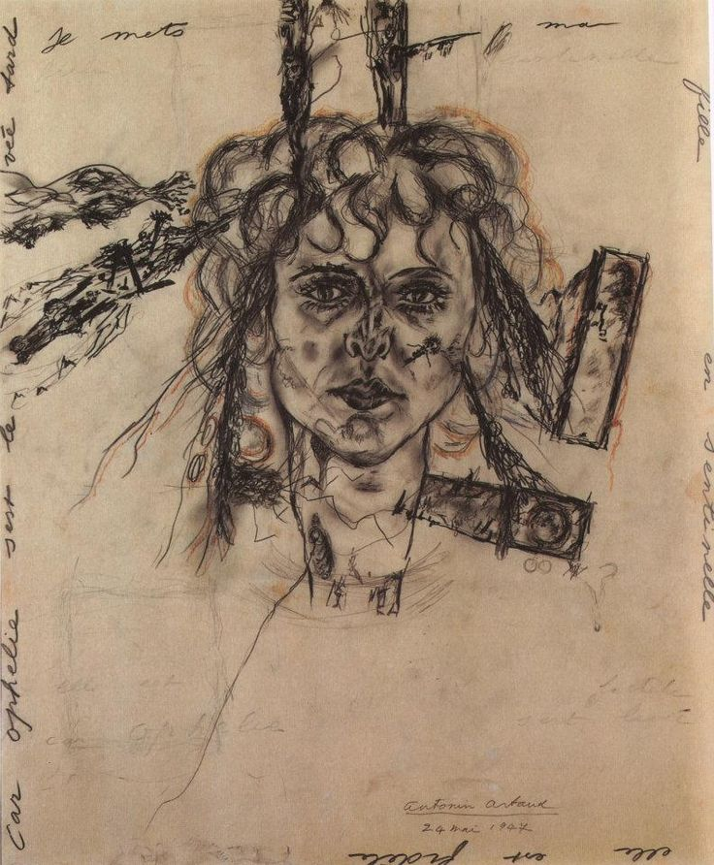
Artaud’s Drawing - spells

Slide 34
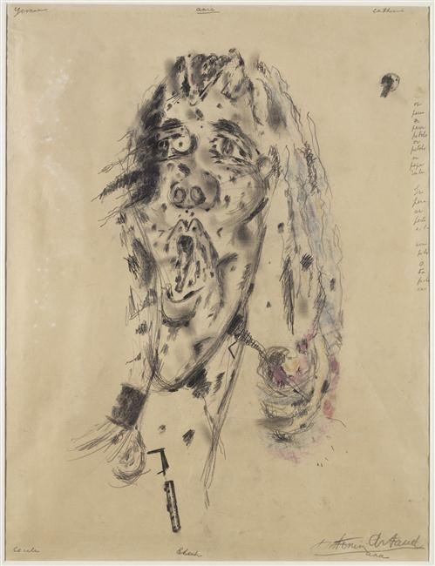

Slide 35
Theatre of Cruelty – final stage
Artaud starts performing again
Extraordinary solo performance in Vieux-Colombier Theatre in 1946 – full of howls, strange gestures and cries
Then he writes and performs the radio play Pour en finir avec le jugement de Dieu (To Have Done with Judgement of God) in 1947, but the performance is banned.
The performance an attack on God and military industrial complex of West, especially destruction of nature and US Marshall Aid. He compares God to shit.

Slide 36
External Context
From World War (1914-8) to World War (1939)
Russian Revolution 1917
Ideology in France
Rise of Communism/Fascism
End of democracy; Wall St Crash (1927)
Second World War – death, camps, atom bomb
Move to a fully urbanised society; machines; cinema; radio; cars; pollution
Artaud lives through all of that; he channels it – this sickness, loss of the human.
So what type of theatre can respond to that?

Slide 37
Context of French Theatre 1 – the avant-garde
Alfred Jarry – Ubu Roi (1896)
Apollinaire – The Breast of Tiresias (1919)
These are avant-garde performance, that predate Dada and Surrealism
Plays that are absurdist, that satirize, violently, bourgeois life, that are meant as provocations, nothing polite about them at all
Then Dada and Surrealist Performance (1916-1925) – to create theatre as an event, a collective riots

Slide 38
Context of French Theatre 2* - Jacques Copeau (1879-1949)
Copeau interested in pure theatre, les bare boards, not literature – le Vieux Colombier (left-bank)
Interest in theatricality (bodies, gestures, movements, scenography, acting styles, costumes)
The art of mise-en-scène but always with classical text
This also was meant to be a spiritual theatre, a type of salvation through art
Theatre as a communication of souls (but through high culture)
Copeau a revolution in technique, purpose, body, actor training (Charles Dullin, Louis Jouvet, Gaston Baty, Etienne Decroux (mime)

Slide 39
Artaud synthesis: revolution in theatre
Artaud’s revolution in theatre is to bring these two context together
From the avant-garde the dream to reject humanist theatre – all the things that Copeau stands for – and a revolutionary politics in which art and life fused
From Copeau – the idea of how theatre needs technique, and that is not just a subset of literature, but an art in its own right. So actor training, gestures, bodies, movement, etc
But for Artaud, not interested in staging plays or in dialogue
Language not abandoned but part of the mix of theatre – it is a material (cries, shouts, etc.)

Slide 40
‘No More Masterpieces’
‘Theatre is the only place in the world, the last general means we still possess of directly affecting the organism, and in periods of neurosis and petty sensuality like the one in which we are immersed, of attacking this sensuality by physical means it cannot withstand’ (81)

Slide 41
Surrealism on stage is perhaps best expressed in Artaud’s work.
But here surrealism goes dark – sexuality, violence, incest, a theatre where image, sound, language, light work as a kind of assault, to open up what is repressed, and to liberate it
A kind of eroticism...and an eroticism that affects us ---theatre as cruelty, as plague, hitting the unconscious

Slide 42
Theatre and Cruelty
Cruelty not physical but psychic, but it works through bodies, as an affect
‘We are not free and the sky can still fall on our heads. And above all else theatre is made to teach us this (Artaud)’.
But cruelty is not literal; it is only by a rigorous attention to form, composition, dramaturgy.
It is not about participation or body art, or blood letting;
It is about affecting us through the movement of the performance – through images, sounds

Slide 43
Artaud’s legacy
Artaud’s theatre didn’t occur in his life time, but huge influence on work of Brook, Grotowski, Kantor, Genet, Beckett, Forced Entertainment, Pina Bausch, physical
A theatre not necessarily of stories but of images, a theatre of perception, bodies.

Slide 44
Artaud’s Revolution
A revolution in theatre
A revolution in how to think of the social/individual/sanity
A revolution of bodies – relation to other bodies, animals, cosmos, matter, energy, unconscious, dreams, myths, primitivism
A revolution in how we relate to nature
In how it makes us rethink mind-body, centrality of human subject, Western values, an attack on commodities, lifestyles, capitalist economics
No ideology or doctrine; the revolution will be theatrical or it will not be – the aim ‘to make our demons flow’ (60)

